Slide 1

Netflix Data: Cleaning, Analyzing and Visualization
Pathan AyanKhan
This Photo by Unknown Author is licensed under CC BY-NC-ND

Slide 2
NETFLIX
Netflix is popular Streaming Service that offers a vast catalog of movies, TV shows and original contents.
The data consist of contents added to Netflix from 2008 to 2021., the oldest content is as old as 1925 and the newest as 2021.

Slide 3
OBJECTIVES:-
Content Type Distribution
Rating Frequency
Top 10 Countries with Most Content
Top 15 Directors with the Most Titles
Top 10 Popular Movie Genres
Monthly Releases of Movies and TV shows
Yearly Releases of Movies and TV shows
Word Cloud of Movie Titles

Slide 4
THE PROCESS:-
Data Collection
Data Cleaning
Data Analysis
Insights
Summary

Slide 5
Data Collection And Data Cleaning
The Data has been Collected in the form of a CSV file named “Netflix1.csv”
We did not find any duplicate or null value, while Cleaning .
We convert the date_added column data to datetime64[ns] type.

Slide 6
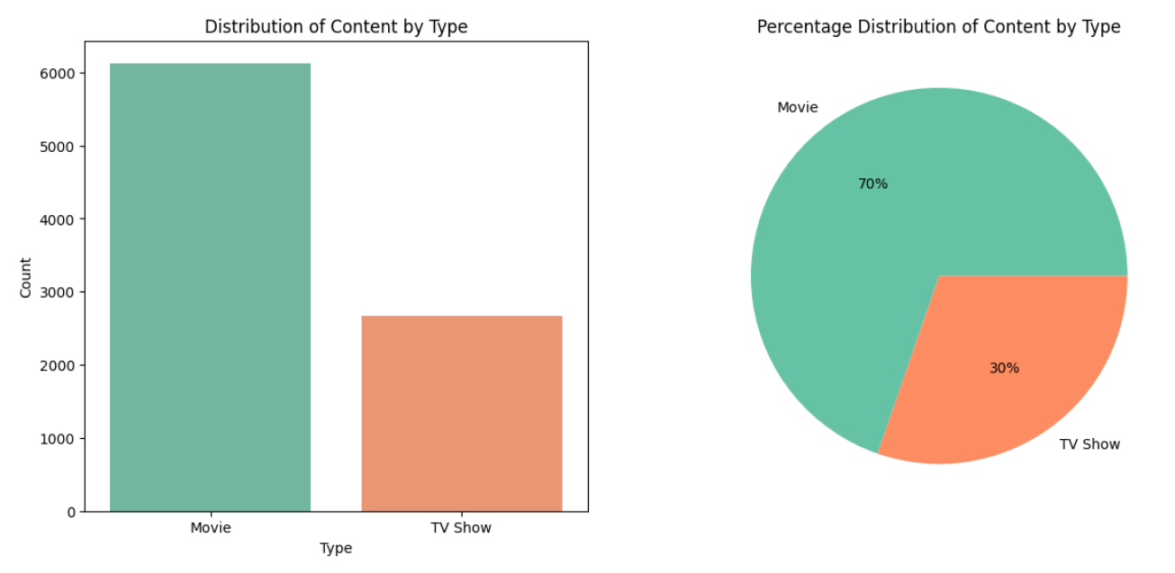
Data Analysis

Slide 7
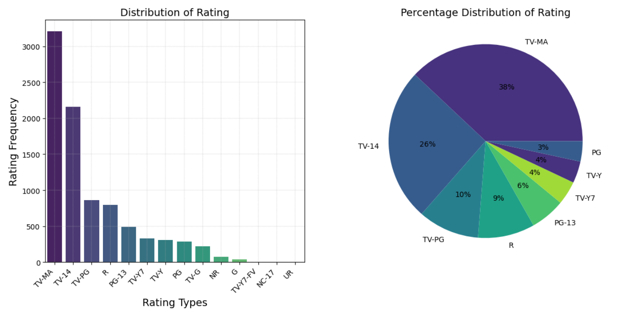
Data Analysis

Slide 8
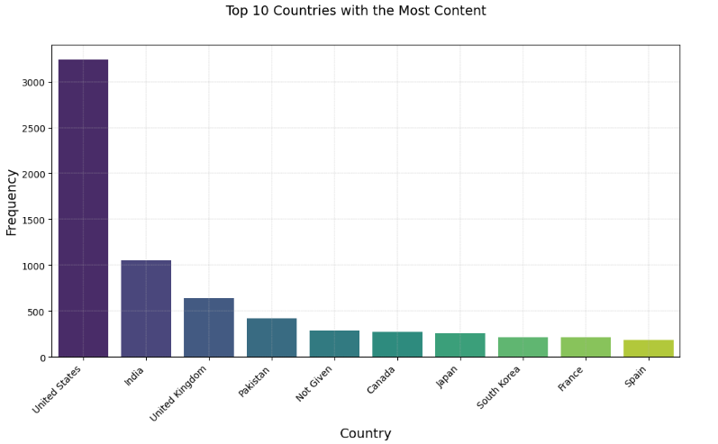
Data Analysis

Slide 9
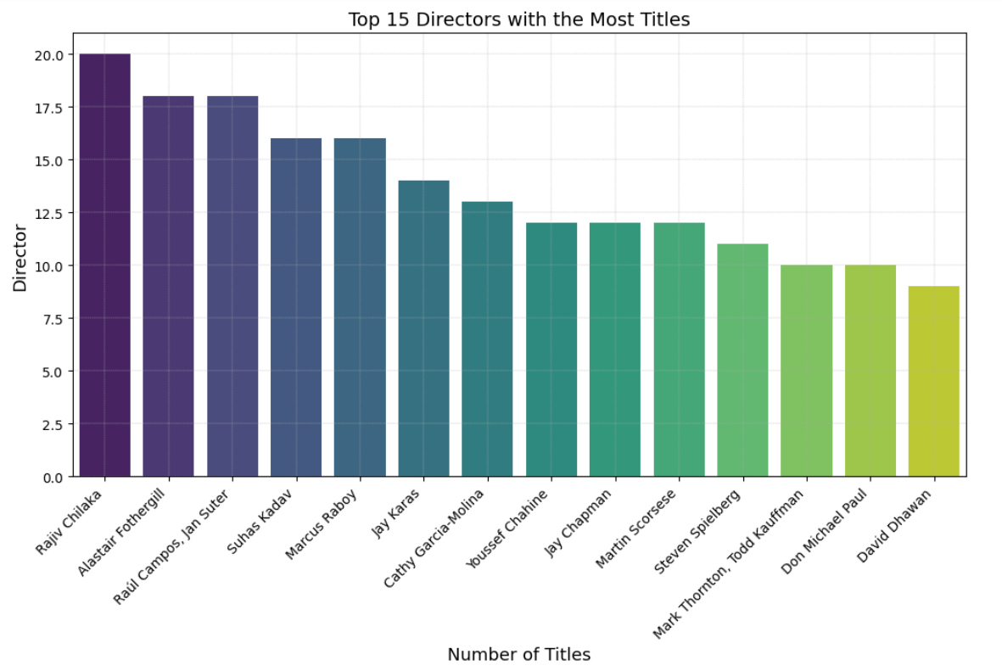
Data Analysis

Slide 10
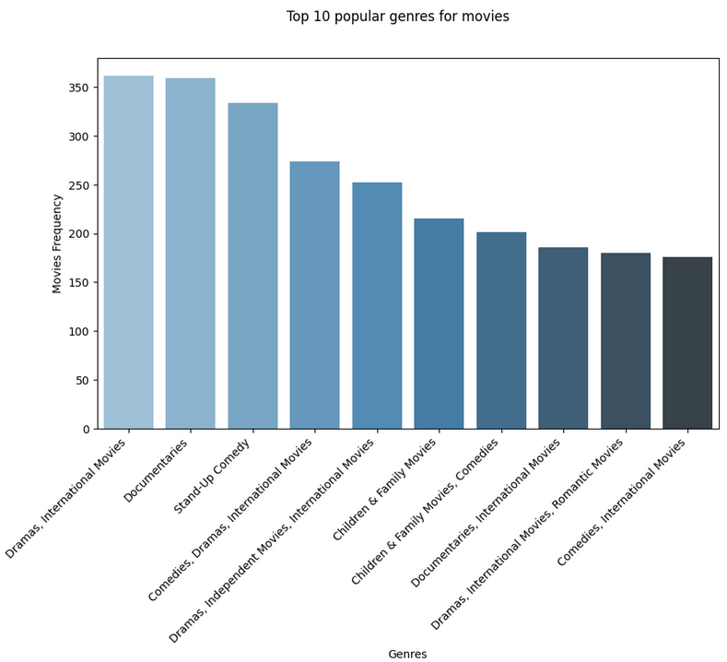
Data Analysis

Slide 11
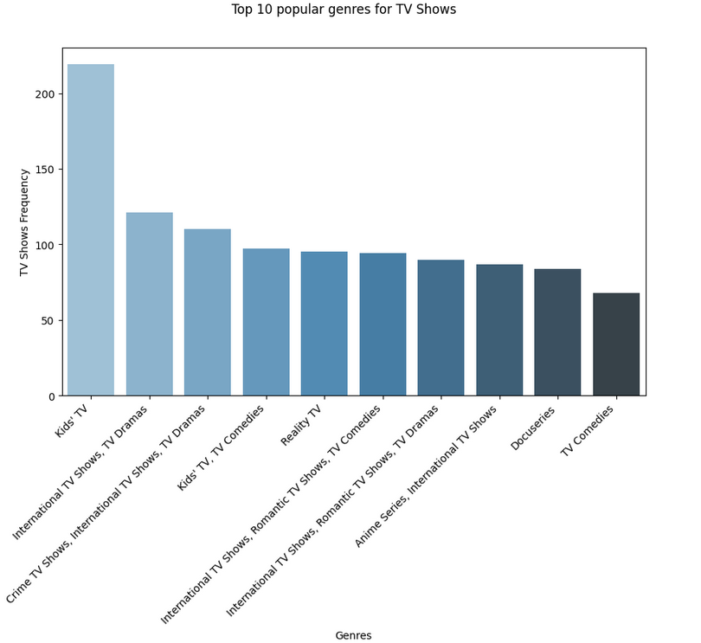
Data Analysis

Slide 12
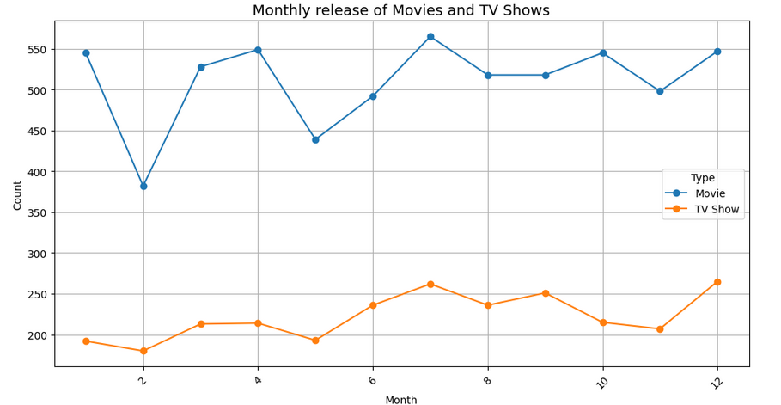
Data Analysis

Slide 13
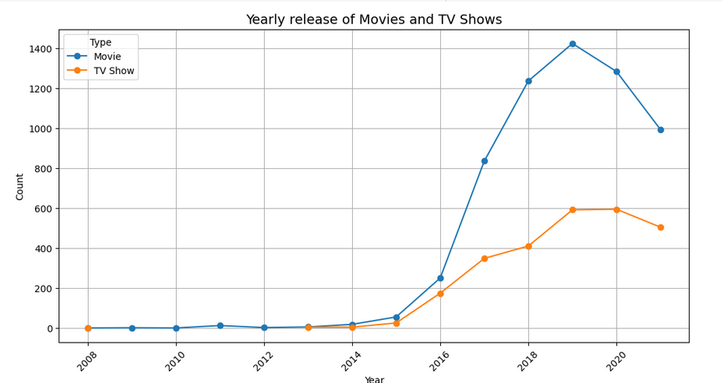
Data Analysis

Slide 14
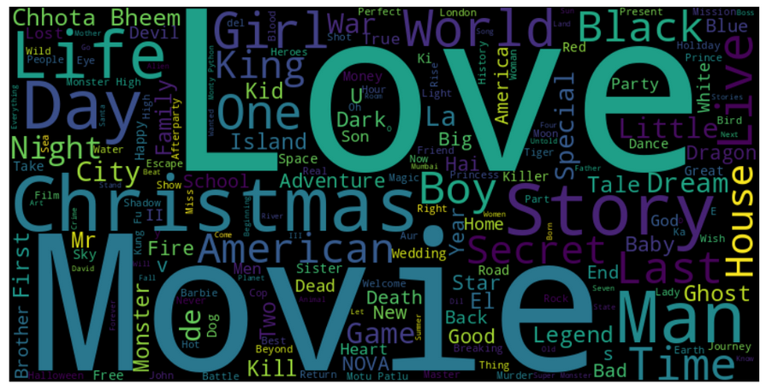
Data Analysis Word Cloud of movie titles

Slide 15
Conclusion
Through this analysis, we have gained valuable insights into the Netflix dataset. We have explored the distribution of content types, genres, and directors, as well as the trends in content release over time. The findings of this analysis can be used to inform content acquisition and production strategies, as well as to identify opportunities for growth and improvement.

Slide 16
Insights
The majority of Netflix content is TV Shows, with a significant increase in TV Show releases over the years.
Movies are the second most common type of content, with a steady release pattern over the years.
The most popular genres are Documentaries, TV Dramas, and Comedies.
The top directors by content count are primarily associated with TV Shows.
There is a clear trend of increasing content release over the years, with a significant spike in 2021.
The word cloud of movie titles highlights the diversity of content available on Netflix.
These insights can be used to guide future content development and acquisition strategies, ensuring that Netflix continues to meet the evolving needs and preferences of its subscribers.

